Slide 1

UNIVERSITI TEKNOLOGI MALAYSIA
SECP3623 - DATABASE PROGRAMMING
2025/2026 - SEM 1
Lab Assignment 1 (5%) - Indexes
Name | : | DHESHIEGHAN A/L SARAVANA MOORTHY
Matric Id | : | A23CS0072
Name | : | PRAVINRAJ A/L SIVABATHI
Matric Id | : | A23CS0171
Name | : | WOO CHENG SHUAN
Matric Id | : | A23CS0283

Slide 2
1. WHAT IS A UNIQUE INDEX?
A Unique Index is a database feature that ensures all the values in a specific column (or group of columns) are unique, meaning no duplicate values are allowed. It helps maintain data integrity by preventing multiple rows from having the same value in the indexed column.
EXAMPLE :
ALTER TABLE customer
ADD UNIQUE idx_email(email);
This command adds a unique constraint on the email column so that no two customers can have the same email address.

Slide 3
2. HOW IT DIFFERS FROM PRIMARY KEY
Feature | Primary Key | Unique Index
Purpose | Identifies each record in a table uniquely. | Ensures that values in a specific column (or columns) are unique.
Number per Table | Only one primary key per table. | You can have multiple unique indexes in a table.
NULL Values | Cannot contain NULL values. | Can contain NULL values (since NULL is not treated as a value).
Automatic Index | Automatically creates a unique index on the primary key column. | Must be manually created using UNIQUE keyword.
Main Role | Used to uniquely identify each row. | Used to prevent duplicate values in certain columns.

Slide 4
3. ADVANTAGES & DISADVANTAGES
Aspect | Advanatges | Disadvantages
Data Integrity | Ensures no duplicate values are inserted in the column. | -
Data Accuracy | Maintains consistent and reliable data in the table. | -
Performance | Speeds up searches and lookups when querying by the unique column. | May slow down INSERT or UPDATE operations because the database must check for duplicates first.
Storage Space | - | Uses extra disk space to store index information.
Flexibility | Can be applied to multiple columns, allowing flexible uniqueness rules. | -

Slide 5
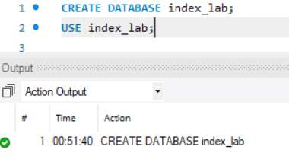
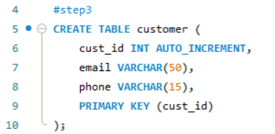
4. CREATE A TABLE
In this step, a new database named index_lab is created and selected for use. Then, a table called customer is created with three columns: cust_id, email, and phone. The cust_id column is set as the primary key with AUTO_INCREMENT, meaning it will automatically assign a unique ID to each customer. This table serves as the basic structure for storing customer information before adding any indexes or constraints.

Slide 6
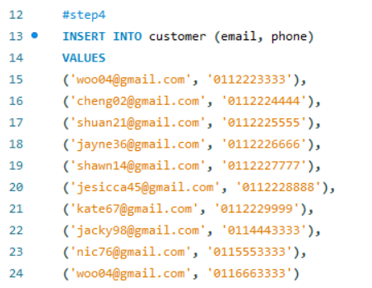
4. INSERT 10 RECORDS
In this step, I inserted 10 records into the customer table using the INSERT INTO SQL statement. Each record contains an email and phone number for different customers. This process helps to populate the database with sample data that can be used for testing and further operations such as retrieving, updating, or deleting records. The query executed successfully, showing that 10 rows were added with no duplicates or warnings.

Slide 7

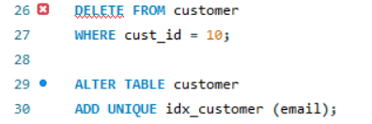

5. ADD A UNIQUE INDEX
In this step, I tried imposing some data integrity on the customer table, by creating a UNIQUE index on the email column. This was done to ensure nobody is using the same email twice, otherwise in future there will be copies. But unfortunately the above query didn't work and it returns with Error Code 1062 as the table already has duplicate email address, in this case 'woo04@gmail.com' is found multiple times. You need to find and auto-correct / delete the duplicates, before being able to add this unique index.
In this step, I first deleted the record with cust_id = 10 from the customer table. This deletion likely removed a duplicate email entry that was causing the previous operation to fail. Following the deletion, I successfully executed the ALTER TABLE statement to add a UNIQUE index (idx_customer) to the email column. This ensures all future entries into the customer table will have a unique email address, enforcing data integrity.

Slide 8
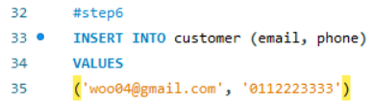
6. INSERT DUPLICATE EMAIL AGAIN
This step was a test designed to show that the UNIQUE index added to the email column in the preceding steps is now working as intended. When I attempted to insert the email 'woo04@gmail.com' (a value already present in the table), the database system immediately prevented the insertion and returned Error Code 1062 (Duplicate entry). This confirms that the data integrity rule requiring unique customer emails is successfully enforced by the database.

Slide 9

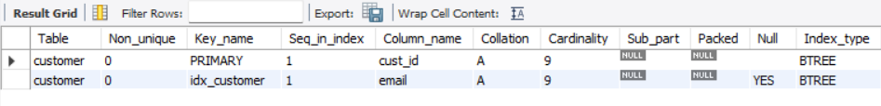
7. USE ‘SHOW INDEX FROM customer’
To resolve the duplicate email issue, I first executed a DELETE statement to remove the problematic record (cust_id = 10). This cleanup allowed the subsequent ALTER TABLE command to successfully add the UNIQUE index (idx_customer) to the email column, enforcing a rule that all future emails must be distinct.
To test this new constraint, I attempted to INSERT a record with a known duplicate email ('woo04@gmail.com'). As intended, the database blocked the operation and returned Error Code 1062, confirming the constraint was active.
Finally, the SHOW INDEX FROM customer; command was used to verify the table structure. The output confirmed the existence of both the PRIMARY key and the new idx_customer (on the email column), both reporting a non_unique value of 0. This final step confirmed that data integrity is now actively secured by the database.

Slide 10
8. HOW A UNIQUE INDEX IMPROVES LOOKUP PERFROMANCE?
A unique index dramatically improves lookup performance by leveraging a highly efficient data structure, typically a B-Tree (Balanced Tree). Instead of requiring the database to perform a slow full table scan (reading every single row) to find a record, the B-Tree organizes the indexed column's data (like email addresses) in a sorted, hierarchical structure.
When a search is performed, the database quickly traverses the B-Tree from the root down to the leaf nodes. This logarithmic time complexity O(log n) ensures that the time required for a lookup remains minimal, even as the table grows to millions of records. Furthermore, the index's unique constraint is key: once the database finds the single matching entry (e.g., a specific email), it immediately stops searching, retrieves the pointer to the full row's data, and fetches the complete record. This combination of a highly organized structure and a guaranteed stopping condition makes indexed lookups significantly faster than unindexed lookups.

Slide 11
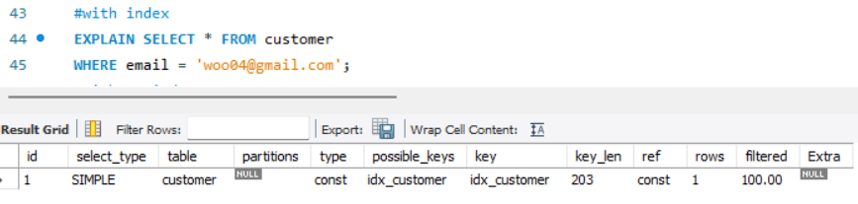
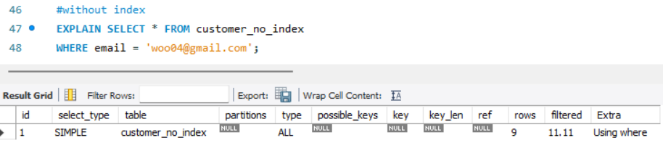
9. COMPARE QUERY PERFORMANCE
WITH INDEX
WITHOUT INDEX
Feature | Execution WITH Index (customer table) | Execution WITHOUT Index (customer_no_index table)
EXPLAIN Type | const (Constant) | ALL (Full Table Scan)
Key Used | idx_customer (The Unique Index) | NULL (No index used)
possible_keys | idx_customer | NULL (No index available)
Rows Examined | 1 | 9
Extra Information | NULL (Clean, direct lookup) | Using where (Had to check the WHERE condition on every row read)
Performance | Extremely Fast (Direct lookup via B-Tree) | Slow (Sequential check of every row)
Scalability | Excellent (O(log n)) – Time barely increases with table size. | Poor (O(n)) – Time increases linearly with table size.

Slide 12
10. REFLECT: WHEN IS A UNIQUE INDEX NOT APPROPRIATE FOR A COLUMN?
1. Expected Duplicate Data
If the column is designed to store values that are naturally repeated, a unique index will cause insert and update operations to fail (Error 1062).
Examples:
first_name or last_name: Many customers will share the same first or last name.
status (e.g., 'Active', 'Inactive', 'Pending'): There are only a few possible values that repeat across all rows.
city or zip_code: Many different customers live in the same location.
order_date: Multiple orders can be placed on the same day.
2. High Write/Update Load (Performance Overhead)
While indexes speed up reads (SELECT), they slow down writes (INSERT, UPDATE, DELETE).
Every time a row is inserted or updated, the database must perform extra work to:
Check for Uniqueness: Read the index to ensure the new value does not already exist.
Maintain the Index: Update the B-Tree structure to include the new value (or remove/update the old value).
If a table has a very high volume of insertions or updates, the cumulative time spent maintaining many indexes (especially unique ones) can slow down the overall application more than the indexing speeds up reads.
3. Extremely Low Cardinality
Cardinality refers to the number of unique values in a column. If a column has very few unique values relative to the total number of rows (low cardinality), an index is generally not helpful for performance.
Example: A boolean is_active column (only two possible values: True or False). If you search for all 'True' rows, the database might find it faster to perform a full table scan than to traverse the index, as the index would point to almost half the table's rows anyway.

Slide 13


THANK YOU
utmofficial
univteknologimalaysia
utm.my

